Slide 1
Lawn Buddy
“The cutting hedge technology”
Milestone #2: Venture Solution Prototype & Social Affordances
Gasser Ahmed
MGT 5824
6/27/2023

Slide 2
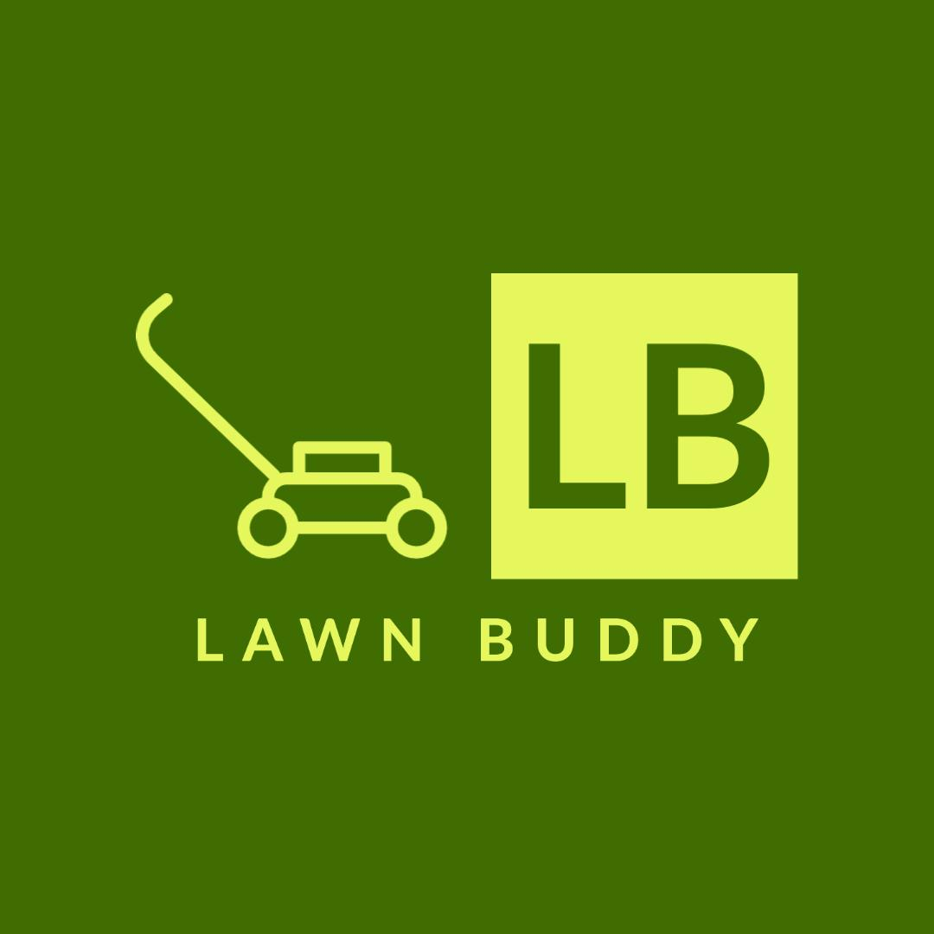
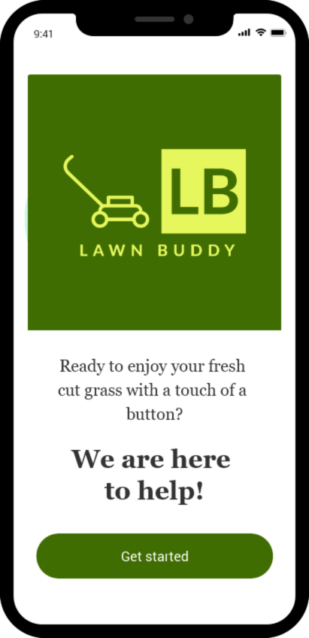
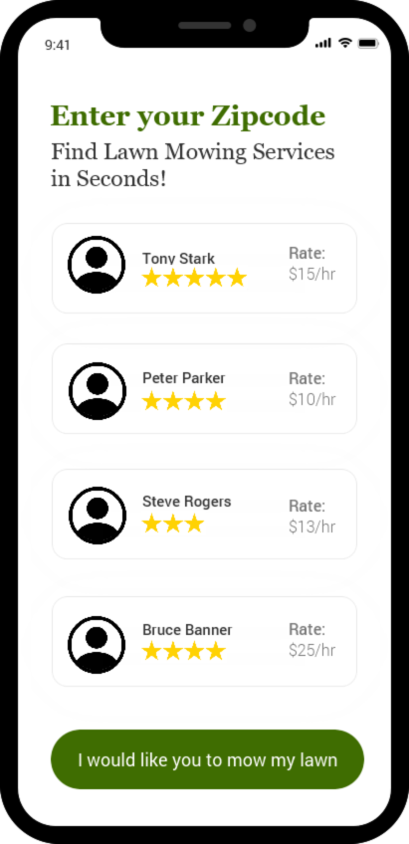
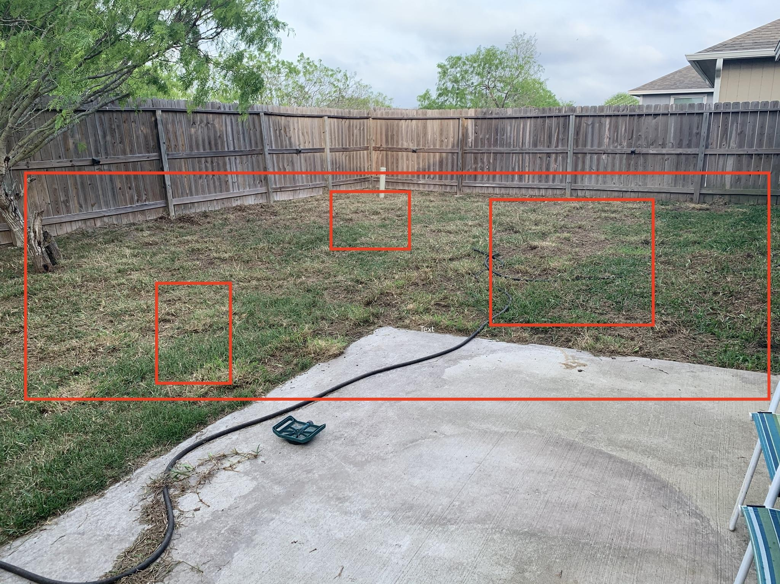

Low-Fidelity Prototype Sketch/Wireframe
Scan
Query
Final Output
Lawn terrain: flat
Suggested Lawn Professional
Lawn quality:
poor
Days
Blade length:
5 inches
Mon
Wed
Fri
Duration
Lawn size: 20 x 35 sq. ft
Weekly
Monthly
Continue to pricing

Slide 3

Low-Fidelity Prototype User Flow/Storyboard
Lawn Buddy
Authentication
Scan Lawn
Dataset
<<selects>>
Service
<<confirms>>
Lawn Professional
Customer
Checkout
Credit Payment Service
Login

Slide 4
Low-Fidelity Prototype Description: Object Recognition
Lawn Buddy has a thorough dataset of all types of lawns in order to have the most accurate reading of the image recognition. By analyzing the pixels in the image recognition, Lawn Buddy can interpret and understand the logistical nature of lawn care services needed.
By analyzing the dataset, Lawn Buddy uses the criteria of computer vision in order to break down the classification, localization and tagging. Lawn buddy uses the classification feature to detect the lawn, and the use of localization to determine lawn size, and the tagging feature to further find the lawn quality, which is measured through lawn color, and blade length which determines when the lawn needs to be trimmed.
Lawn quality: measured by the appearance and color of the lawn. Ex. yellow lawn = poor quality
Blade length: measured by analyzing the individual blade. Ex. blade > 3 inches = long, time for maintenance
Lawn size: measured by the phone's AR feature. Ex. 20 x 15 sq. ft.
Lawn terrain: measured by the topography of the yard. Ex. hills = non-flat terrain
Lawn Buddy uses location services to determine weather patterns like rain and drought to determine the rate of grass growth and then lawn maintenance scheduling.

Slide 5
Low-Fidelity Prototype Description: Use Case
A differently abled person wishes to take care of his lawn but physically can not do so. He wants to find the best price in his area, so he downloads Lawn Buddy. He uses the object recognition technology that is featured in the app in order to scan his lawn. From his window, he is able to get a good image of his front yard and the Lawn Buddy app detects his lawn size, lawn terrain, lawn quality, and lawn blade length. By determining the four criteria, Lawn Buddy will automatically create a schedule for lawn maintenance, as well as suggesting a lawn professional and his price ranges. The individual will confirm the scheduling details, and lawn criteria, and his lawn will be under the care of Lawn Buddy for the length of time he desires. Lawn Buddy is able to provide lawn maintenance up to once year in advance.
On the scheduled day, the lawn professional comes to your domicile, and provides the lawn care services needed and leaves. His payment and tip is fulfilled through the app, so no contact needed.
By using the image recognition technology from Lawn Buddy, the checkout experience is more efficient and user-friendly, especially for sick, elderly or differently abled persons that like to enjoy a maintained lawn.

Slide 6
Social and Technological Affordances User Interaction
The AI lawn mowing scheduling app offers a user-friendly interface with intuitive interactions, ensuring a seamless user experience.
Users can easily schedule mowing sessions, manage their lawn care preferences, and view upcoming appointments.
The app provides clear instructions and guidance throughout the scheduling process, reducing user effort and minimizing cognitive load.
Accessibility features, such as adjustable font sizes, color contrast options, and voice-guided navigation, enhance inclusivity for users with diverse needs.
Push notifications and reminders keep users informed about upcoming appointments, improving engagement and reducing the likelihood of missed sessions.

Slide 7
Social and Technological Affordances Social Implications
The app contributes to environmental sustainability by optimizing lawn care practices, reducing emissions, and promoting water and chemical conservation.
It may have social implications regarding job displacement for traditional lawn care workers, necessitating considerations for retraining or alternative employment opportunities.
Ethical considerations include ensuring data privacy and security, transparent use of customer information, and responsible AI decision-making processes.
Users benefit from the convenience and time-saving aspects of the app, allowing them to focus on other activities or spend quality time with family and friends.
The app's automation of lawn care tasks reduces human labor, potentially freeing up resources for other important societal needs.

Slide 8
Social and Technological Affordances Technological Affordances
The AI lawn mowing scheduling app leverages current technology, particularly object recognition, to accurately identify lawn boundaries and obstacles.
Object recognition algorithms analyze images captured by the app's camera or uploaded by the user, identifying objects such as trees, flowerbeds, and fences.
The app evaluates the accuracy and reliability of object recognition, considering factors like lighting conditions and potential limitations in detecting complex or irregular lawn shapes.
Pushing technological boundaries may involve exploring advanced object recognition techniques, such as machine learning and deep neural networks, to improve the precision and efficiency of lawn boundary detection.
The app's use of object recognition technology enhances the accuracy of lawn measurements, ensuring optimal scheduling and mowing coverage.
Notes:
By prioritizing user experience, considering social implications and ethical considerations, and leveraging object recognition technology, the AI lawn mowing scheduling mobile app offers a convenient and responsible solution for lawn care. It provides users with a user-friendly interface, contributes to environmental sustainability, and addresses potential job displacement concerns. The app's use of object recognition technology improves measurement accuracy, making scheduling more efficient and optimizing the mowing process. While continuously evaluating and pushing technological boundaries, it aims to provide a positive impact on users and the broader community.

Slide 9
AI Technology Stack Schematics Hardware and Infrastructure: Hardware Components
User Devices:
Smartphones or tablets: These devices act as the primary interface for users to interact with the app and schedule mowing sessions.
Cameras: User devices with built-in cameras capture images of the lawn for object recognition and measurement.
Object Recognition and Measurement:
Image Processing Unit (IPU): Integrated into user devices, IPUs assist in accelerating image processing tasks.
Deep Learning Models: Pretrained convolutional neural network (CNN) models capable of detecting and segmenting objects within the lawn images.

Slide 10
AI Technology Stack Schematics Hardware and Infrastructure: Cloud Services
Amazon EC2 Cloud Computing: Compute Cloud provides resizable compute capacity for hosting backend services, handling user requests, data flow, business logic, AI model training, and inference.
Amazon S3 Cloud Storage: Provides scalable and secure cloud storage for storing user data, including lawn images, preferences, and schedules.
Amazon SageMaker AI Model Training: A fully managed machine learning service that provides infrastructure for training and deploying models at scale.
Amazon Redshift Data Analytics: A fully managed data warehousing service for analyzing large datasets and deriving insights.

Slide 11
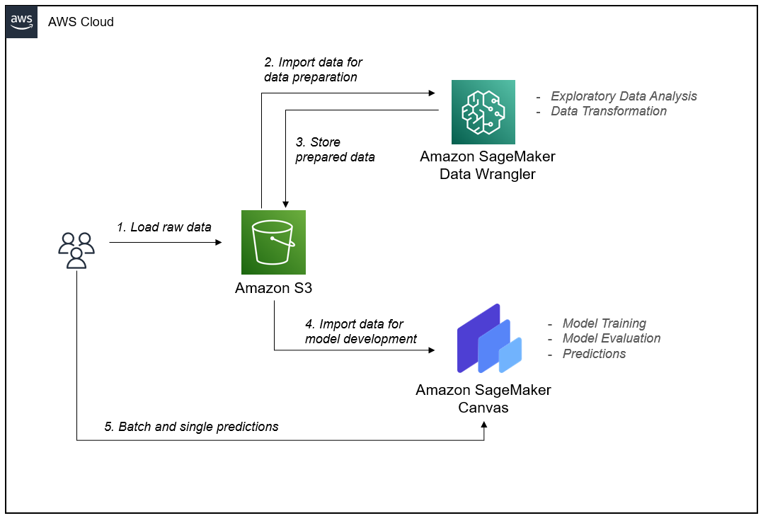
AI Technology Stack Schematics Hardware and Infrastructure: Amazon SageMaker Workflow
Notes:
https://aws.amazon.com/blogs/machine-learning/build-a-risk-management-machine-learning-workflow-on-amazon-sagemaker-with-no-code/

Slide 12
AI Technology Stack Schematics Software
Programming Language and Development Tools:
JavaScript: The primary language for React Native app development.
Node.js: A JavaScript runtime environment that provides the necessary tools for server-side development and package management.
npm (Node Package Manager): A package manager for installing and managing JavaScript libraries and dependencies.
React Native and Related Libraries:
React Native: A JavaScript framework for building cross-platform mobile applications.
Expo: A set of tools and services for developing and deploying React Native apps with ease.
Axios: A promise-based HTTP client for making API requests from the app.
Formik: A library for building forms and managing form state.

Slide 13
AI Technology Stack Schematics Software
AI and Machine Learning Frameworks:
TensorFlow.js: A JavaScript library for training and deploying machine learning models directly in the browser or on the device.
MobileNet: A pre-trained deep learning model for image classification that can be used for object recognition in the lawn images.
OpenCV.js: A JavaScript port of OpenCV, providing computer vision functionalities for image processing and analysis.
Weather Data APIs: Integration with weather data APIs (e.g., OpenWeatherMap, Weather API) for incorporating weather conditions into mowing schedules.
Visual Studio Code IDE: A popular lightweight IDE for web and mobile app development with support for React Native.

Slide 14
AI Technology Stack Schematics Data
User Data:
User Profiles: Data such as names, contact information, and preferences (e.g., mowing frequency, preferred dates) are collected during the user registration process.
Lawn Measurements: Users provide lawn dimensions either manually or using object recognition algorithms to measure the lawn area accurately.
Scheduling Data: Information about scheduled mowing sessions, including dates, times, and frequency, is collected to manage and organize the mowing service.
Data Collection:
User Input: Users enter their profile information, lawn measurements, and scheduling preferences directly into the app.
Object Recognition: If object recognition algorithms are used for lawn measurement, images of the lawn are captured either through the app's camera or uploaded by the user.

Slide 15
AI Technology Stack Schematics Data
Data Processing:
Image Processing: If object recognition is involved, the images captured by the app's camera or uploaded by the user are processed to detect and identify objects like trees, flowerbeds, or fences.
Data Validation: User input for scheduling preferences is validated to ensure consistency and adherence to specified constraints.
Weather Data Integration: If incorporating weather conditions, weather data from external APIs is retrieved and processed to determine optimal mowing schedules.
Data Storage:
User data (including profile information and scheduling preferences), lawn images, and information about scheduled mowing sessions and completed sessions (for efficient retrieval and management) will be stored in Amazon S3 cloud storage.
Analytics Data: App usage and performance data, such as user interactions and errors, will be collected and stored for analysis and improvement.
(Additional Data Security and Privacy info are included below in the Notes section)
Notes:
Data Security and Privacy:
Secure Data Transmission: Secure communication protocols (e.g., HTTPS) to encrypt data transmission between the mobile app and backend servers, protecting user data from unauthorized interception.
Strong User Authentication and Access Control: Robust user authentication mechanisms (e.g., passwords, biometrics) to ensure only authorized users can access the app. Apply access controls to restrict data access based on user roles and privileges.
Encryption and Data Storage: Encryption techniques to protect sensitive user data, both in transit and at rest. Use secure storage mechanisms, such as encrypted databases or cloud storage services, to safeguard user information.
Privacy Policy and User Consent: Create a comprehensive privacy policy that outlines the types of data collected, the purposes of data usage, and how user privacy is protected. Obtain informed consent from users for data collection, storage, and usage, and provide options for users to manage their data preferences.
Compliance with Data Protection Regulations: Adhere to relevant data protection regulations, such as GDPR or CCPA, by ensuring user rights are respected, providing transparency in data practices, and facilitating user data access, modification, and deletion requests.

Slide 16
AI Technology Stack Schematics Algorithms
Object Recognition:
MobileNet: MobileNet is a lightweight convolutional neural network (CNN) architecture specifically designed for mobile and embedded vision applications. It is efficient and suitable for real-time object recognition tasks.
TensorFlow: TensorFlow is an open-source machine learning framework that can be used to train and deploy deep learning models, including MobileNet.
Training Process:
Dataset Preparation: Collect a labeled dataset of lawn images containing various objects like trees, flowerbeds, fences, and obstacles, along with their corresponding labels.
Model Training: Utilize Amazon SageMaker's training capabilities with TensorFlow to train the MobileNet model on the lawn-specific dataset. This involves feeding the labeled images into the model, adjusting the model's internal parameters (weights and biases) through an optimization process, and iterating to improve its accuracy.

Slide 17
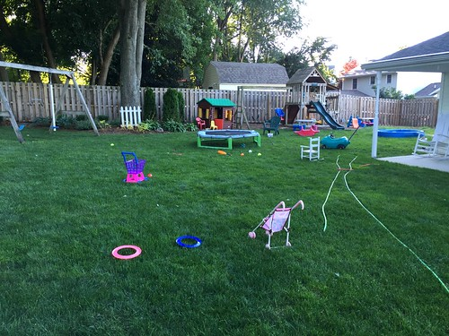
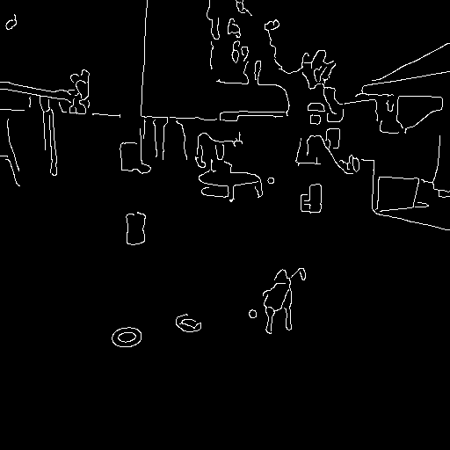
AI Technology Stack Schematics Algorithms
Image Processing:
Utilize OpenCV.js (a JavaScript library that provides computer vision algorithms for image processing and analysis tasks) to perform Canny edge detection algorithm. This algorithm helps identifying lawn boundaries and object edges within the lawn images, enabling accurate lawn measurement and obstacle detection.
Original Image
Edge Image

Slide 18
AI Technology Stack Schematics Algorithms
Machine Learning:
Regression Models: predict optimal mowing schedules based on factors like lawn size, weather conditions, and growth patterns.
Training Process:
Dataset Collection: Gather historical data on mowing schedules, lawn sizes, weather conditions, and other relevant factors.
Data Preparation: Preprocess the dataset by performing feature engineering, handling missing values, and scaling numerical features.
Model Training: Utilize machine learning algorithms like linear regression, decision trees, or random forests to train the model on the prepared dataset. The training process involves feeding the data into the model, optimizing the model's parameters, and iteratively improving its performance.

Slide 20
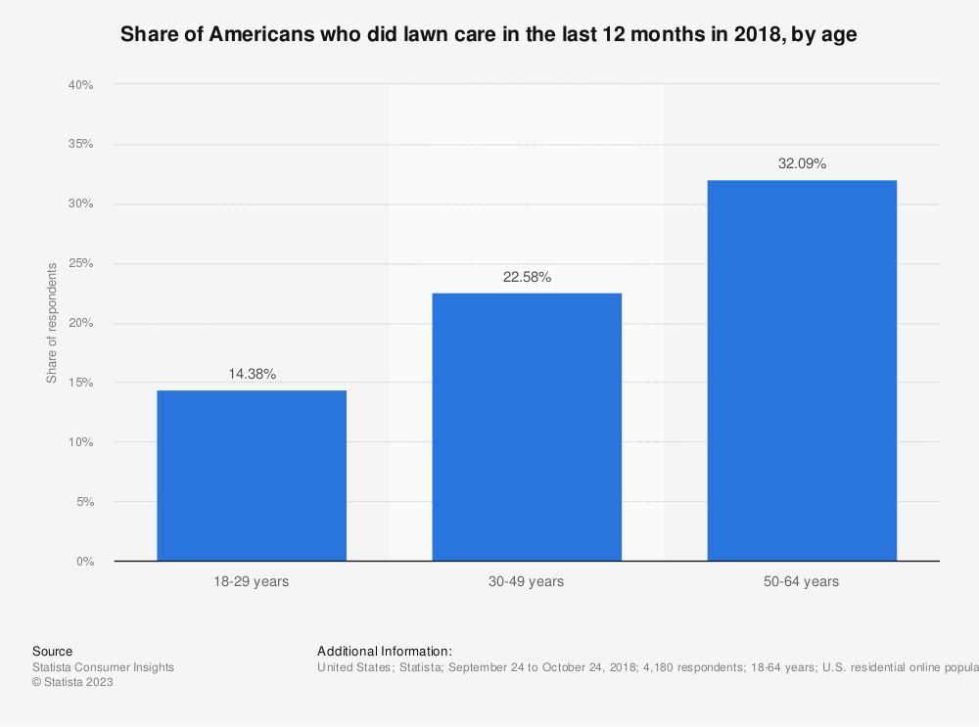
Identification of Target Customer Segment Criteria: Age
The age group of 50-64 years represents the largest share of respondents at 32.09%. This indicates that middle-aged individuals are the most prominent demographic interested or engaged in lawn mowing activities.
The 30-49 years age group follows closely behind with a share of 22.58% of respondents. This suggests that individuals in their prime working years also have a significant presence in the lawn mowing market.
The 18-29 years age group comprises a smaller share of respondents at 14.38%. This indicates that younger individuals have a relatively lower level of interest or involvement in lawn mowing activities compared to other age groups surveyed.
The data highlights the importance of targeting middle-aged and older individuals as the primary customer segment.

Slide 21
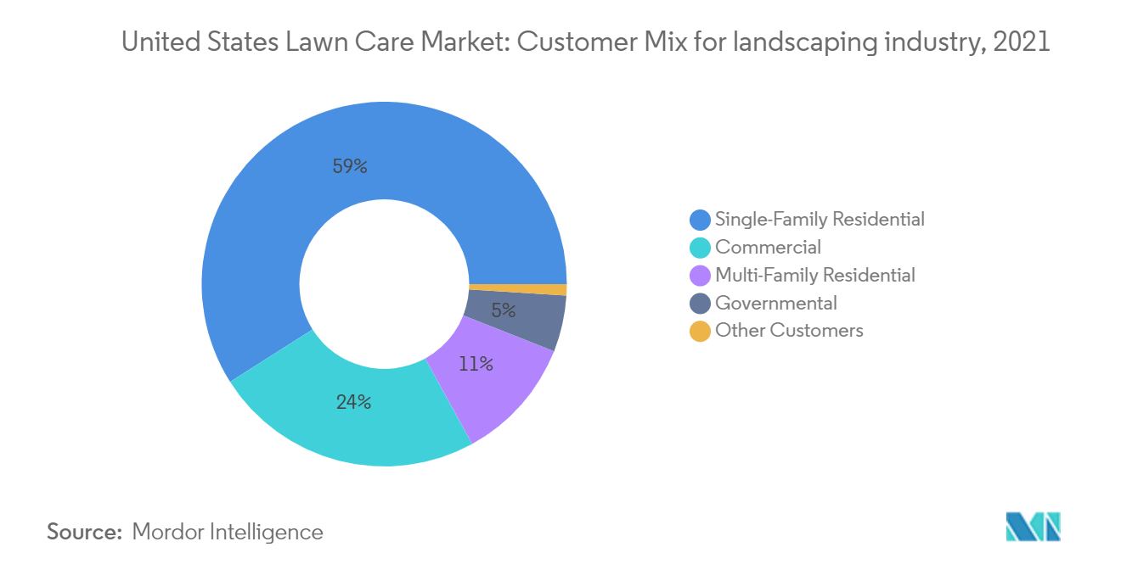
Identification of Target Customer Segment Criteria: Customer Type
Single-family residential customers represent the largest customer segment, accounting for 59% of the total customer base. This suggests that homeowners who own single-family properties are the primary consumers of lawn mowing services.
The commercial segment comprises 24% of the customer base, indicating that businesses and commercial properties are significant customers for lawn mowing services. This includes retail stores, offices, and other non-residential establishments.
The multi-family residential segment represents 11% of the customer base, such as property owners or managers of multi-unit residential buildings
The governmental segment accounts for 5% of the customer base, suggesting that government entities and institutions, such as public parks or government-owned properties, require lawn mowing services as well.

Slide 22
Identification of Target Customer Segment Most Suitable Customer Segment
The combination of the market size and potential growth, along with the age distribution and customer type data, underscores the suitability of middle-aged and older individuals within the single-family residential customer segment as the most suitable target for a lawn mowing business for the following reasons:
Market Size and Potential Growth: The market size for lawn mowing has consistently grown over the years, indicating a robust industry. From 2013 (83.25 billion) to 2023 (176 billion), the market size has nearly doubled, demonstrating a significant growth potential. Single-family residential customers, representing the largest customer segment have contributed to this growth and are likely to continue driving market expansion.
Age Distribution: The data on age distribution shows that the 50-64 years age group accounts for the highest share of respondents. This aligns with the middle-aged and older demographic targeted within the single-family residential customer segment. The higher proportion of individuals in this age group indicates a larger pool of potential customers who are likely to require lawn mowing services.
Customer Type Distribution: Among the customer types, single-family residential customers make up the majority at 59%. This data further emphasizes the significance of targeting this customer segment. By focusing on single-family residential customers, Lawn Buddy can tap into the largest customer base, ensuring a steady flow of work and revenue. Additionally, the 24% share of commercial customers can serve as an additional revenue stream, but the dominant presence of single-family residential customers highlights their suitability as the primary target.
(Additional justifications are included below in the Notes section)

Slide 23
Identification of Key Customer Problems Primary Data Strategy: Interviews
Participant #1
Can you tell me about your experience and challenges with mowing your lawn?
Mowing the lawn has always been a physically demanding task for me. As I've gotten older, the manual labor involved has become increasingly challenging.
Can you describe any physical limitations or health conditions that may affect your ability to mow your lawn efficiently? How do these limitations impact your overall lawn care routine?
I have arthritis, which makes gripping and maneuvering a traditional lawnmower handle quite painful and difficult.
What specific features or capabilities would you look for in an AI-powered lawn mowing solution? How do you envision such a solution would make your lawn care routine easier, more efficient, or more enjoyable?
I would love an AI-powered lawn mowing solution that can automatically detect and avoid obstacles, such as trees, flower beds, or children's toys, ensuring a seamless mowing experience.
What are your expectations in terms of affordability and pricing for an AI-powered lawn mowing solution?
Affordability is crucial to me. I would expect an AI-powered lawn mowing solution to be reasonably priced, considering the potential long-term savings it offers compared to hiring professional lawn care services.
Participant #2
Can you tell me about your experience and challenges with mowing your lawn?
The most difficult aspect of mowing my lawn is the time it takes. It feels like a never-ending task, and I struggle to find enough time in my busy schedule.
Can you describe any physical limitations or health conditions that may affect your ability to mow your lawn efficiently? How do these limitations impact your overall lawn care routine?
Due to a back injury, I have limited mobility and cannot bend over or push heavy equipment for extended periods, making mowing my lawn a daunting task.
What specific features or capabilities would you look for in an AI-powered lawn mowing solution? How do you envision such a solution would make your lawn care routine easier, more efficient, or more enjoyable?
It would be great if the solution could adapt to different lawn sizes and terrains, adjusting its mowing patterns accordingly to ensure complete and even coverage.
What are your expectations in terms of affordability and pricing for an AI-powered lawn mowing solution?
Ideally, the pricing should be transparent, with no hidden costs or ongoing subscription fees that could make the solution financially burdensome in the long run.

Slide 24
Identification of Key Customer Problems Primary Data Strategy: Interviews
Participant #3
Can you tell me about your experience and challenges with mowing your lawn?
I find it particularly challenging to maneuver around obstacles like trees, flower beds, and uneven terrain. It requires a lot of precision and can be time-consuming.
Can you describe any physical limitations or health conditions that may affect your ability to mow your lawn efficiently? How do these limitations impact your overall lawn care routine?
I suffer from respiratory issues, and the dust and allergens stirred up during mowing exacerbate my condition, causing discomfort and breathing difficulties.
What specific features or capabilities would you look for in an AI-powered lawn mowing solution? How do you envision such a solution would make your lawn care routine easier, more efficient, or more enjoyable?
Weather conditions play a significant role in my lawn care routine. Having an AI-powered solution that can autonomously schedule mowing based on weather forecasts would be incredibly convenient.
What are your expectations in terms of affordability and pricing for an AI-powered lawn mowing solution?
I would appreciate different pricing options, such as flexible payment plans or rental options, to make the solution more accessible to a broader range of individuals.
Participant #4
Can you tell me about your experience and challenges with mowing your lawn?
Dealing with the aftermath of mowing, such as disposing of grass clippings or cleaning the mower, can be quite bothersome and adds to the overall effort required.
Can you describe any physical limitations or health conditions that may affect your ability to mow your lawn efficiently? How do these limitations impact your overall lawn care routine?
As someone with a heart condition, the physical strain of mowing puts a strain on my cardiovascular system, and I need to be cautious not to overexert myself.
What specific features or capabilities would you look for in an AI-powered lawn mowing solution? How do you envision such a solution would make your lawn care routine easier, more efficient, or more enjoyable?
I envision a solution with smart sensors that can detect the grass length and adjust the cutting height accordingly, maintaining an optimal lawn appearance without any manual intervention.
What are your expectations in terms of affordability and pricing for an AI-powered lawn mowing solution?
It would be helpful if the solution offers a warranty or service package to ensure that any maintenance or repairs are covered, minimizing additional costs and providing peace of mind.

Slide 25
Identification of Key Customer Problems Primary Data Strategy: Interviews
Participant #5
Can you tell me about your experience and challenges with mowing your lawn?
I live in a hot climate, and the physical exertion and exposure to the sun during mowing can be exhausting and sometimes even unsafe.
Can you describe any physical limitations or health conditions that may affect your ability to mow your lawn efficiently? How do these limitations impact your overall lawn care routine?
My vision has deteriorated with age, and it's challenging for me to see obstacles or uneven terrain while mowing, increasing the risk of accidents or injuries.
What specific features or capabilities would you look for in an AI-powered lawn mowing solution? How do you envision such a solution would make your lawn care routine easier, more efficient, or more enjoyable?
It would be beneficial if the solution could provide real-time updates or notifications on its progress, allowing me to monitor the mowing process remotely or through a mobile app.
What are your expectations in terms of affordability and pricing for an AI-powered lawn mowing solution?
While I understand that an AI-powered solution may come at a premium, I would expect its pricing to be competitive compared to other advanced lawn care alternatives available in the market.
Participant #6
Can you tell me about your experience and challenges with mowing your lawn?
The noise generated by traditional lawnmowers is a significant challenge for me, as it disturbs my peace and can be bothersome to my neighbors.
Can you describe any physical limitations or health conditions that may affect your ability to mow your lawn efficiently? How do these limitations impact your overall lawn care routine?
I have a chronic condition that affects my energy levels, and mowing the lawn can leave me fatigued for the rest of the day, impacting my overall productivity.
What specific features or capabilities would you look for in an AI-powered lawn mowing solution? How do you envision such a solution would make your lawn care routine easier, more efficient, or more enjoyable?
Aesthetics matter to me. It would be great if the solution could create artistic patterns or designs while mowing, adding a touch of creativity to my lawn.
What are your expectations in terms of affordability and pricing for an AI-powered lawn mowing solution?
Affordability aside, I believe the pricing should align with the overall quality, reliability, and performance of the AI-powered lawn mowing solution

Slide 26
Analysis of Customer Discovery Data Organization and Structuring of Data
Participant | Experience and Challenges | Physical Limitations or Health Conditions | Desired Features or Capabilities | Affordability and Pricing Expectations
Participant 1 | Physical exertion | Arthritis, limited mobility, vision problems | Automatic obstacle detection, real-time updates | Affordable pricing, warranties/service packages
Participant 2 | Time consumption | Back injury, limited mobility | Adaptability, smart sensors | Reasonable pricing, no hidden costs, transparent pricing
Participant 3 | Time consumption, obstacles | Respiratory issues, allergies | Weather-based scheduling | Flexible payment plans
Participant 4 | Post-mowing tasks | Heart condition | Adaptability, smart sensors | Transparent pricing, service packages
Participant 5 | Physical exertion, hot weather | Vision problems | Real-time updates | Affordable pricing, competitive pricing
Participant 6 | Noise pollution | Chronic fatigue | Aesthetics | Affordable pricing, quality-performance balance

Slide 27
Analysis of Customer Discovery Data Qualitative Analysis
After reviewing the answers provided for the interview questions, we can perform a qualitative analysis to identify common themes and patterns. Here are the key findings from the analysis:
1. Experience and challenges with mowing the lawn:
Physical exertion and time consumption were the most common challenges mentioned.
Maneuvering around obstacles and dealing with post-mowing tasks were also significant difficulties.
The impact of hot weather and noise pollution were highlighted as additional challenges.
2. Physical limitations or health conditions:
Arthritis, back injuries, and limited mobility were mentioned as physical limitations affecting lawn mowing.
Respiratory issues, heart conditions, and vision problems were also mentioned as health conditions impacting the ability to mow efficiently.
Chronic fatigue or low energy levels were mentioned as factors affecting post-mowing productivity.
3. Desired features or capabilities in an AI-powered solution:
Automatic obstacle detection and avoidance was a highly desired feature.
Adaptability to different lawn sizes and terrains was emphasized.
Weather-based scheduling and smart sensor technology for optimal cutting height were also mentioned.
Real-time updates and remote monitoring capabilities were seen as beneficial.
Aesthetically pleasing patterns or designs created during mowing were appreciated.
4. Expectations regarding affordability and pricing:
Affordability was a key concern, with a desire for reasonable pricing.
Transparent pricing without hidden costs or subscription fees was preferred.
Flexible payment plans and rental options were mentioned to increase accessibility.
Assurance through warranties or service packages was seen as important.
Pricing should be competitive while reflecting the quality and performance of the solution.

Slide 28
Analysis of Customer Discovery Data Analysis Results Interpretation
The qualitative analysis of the previous results provides valuable insights into the customer problems related to mowing the lawn for middle-aged and older individuals in single-family residential areas. Here's an interpretation of the analysis results in the context of customer problems:
Physical Challenges: The analysis reveals that customers in this demographic face physical challenges when mowing their lawns. Conditions such as arthritis, back injuries, limited mobility, respiratory issues, and heart conditions hinder their ability to efficiently perform the task. These physical challenges contribute to the difficulty, time consumption, and exhaustion associated with lawn mowing.
Time Constraints and Difficulty: Customers expressed concerns about the time-consuming nature of mowing their lawns, which aligns with their busy schedules. Additionally, the difficulty of maneuvering around obstacles and dealing with post-mowing tasks adds to the overall challenge. These issues emphasize the need for a solution that reduces the physical effort required and streamlines the mowing process.
Health-related Limitations: The analysis highlights the impact of health conditions on the customers' ability to mow efficiently. Vision problems, chronic fatigue, and other health issues further hinder their lawn care routine, making it even more challenging for them to maintain their lawns. This emphasizes the need for a solution that accommodates and supports individuals with various health-related limitations.
Desired Features and Capabilities: Customers expressed their expectations regarding features and capabilities they would like to see in an AI-powered lawn mowing solution. The most desired features include automatic obstacle detection and avoidance, adaptability to different lawn sizes and terrains, weather-based scheduling, and real-time updates. Aesthetically pleasing patterns or designs created during mowing were also appreciated. These desired features aim to simplify the lawn care routine, increase convenience, and provide a visually appealing outcome.
Affordability and Pricing Expectations: Affordability emerged as a significant concern among customers. They expect reasonable pricing without hidden costs or subscription fees. Flexible payment plans and rental options were also mentioned as ways to increase accessibility. Customers believe that the pricing should be competitive, considering the quality and performance of the AI-powered solution.

